Slide 1







Japan Trip 2012
+

Slide 2

Japan Trip 2012
+

Slide 5
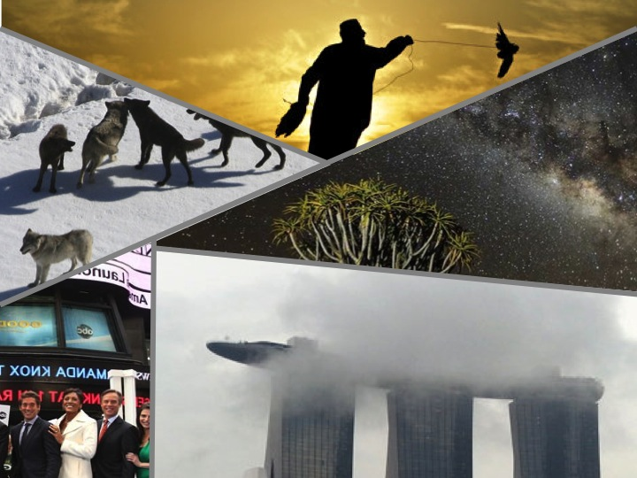

Birds fly freely

Slide 6
1
2
4
5
3

Slide 7
Shared
Shared By Me
Japan 2012
Korea 2012
India 2012
Tom Hang
Tim Koo
Steve Wong
Shared With Me
Japan 2012
Korea 2012
India 2012
Tom Hang
Tim Koo
Steve Wong

Slide 8
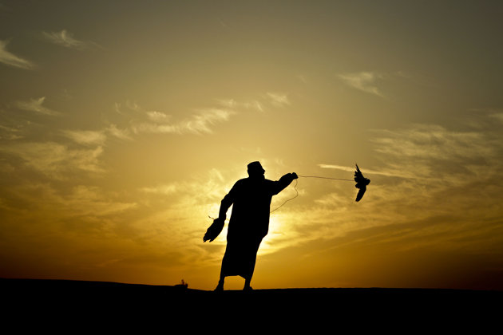

Birds fly freely

Slide 9




Birds fly freely

Slide 10



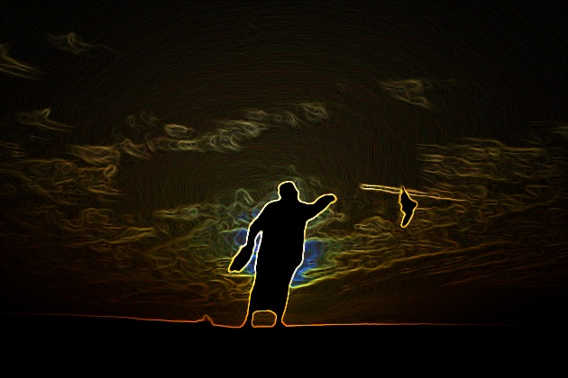
Birds fly freely

